Slide 1
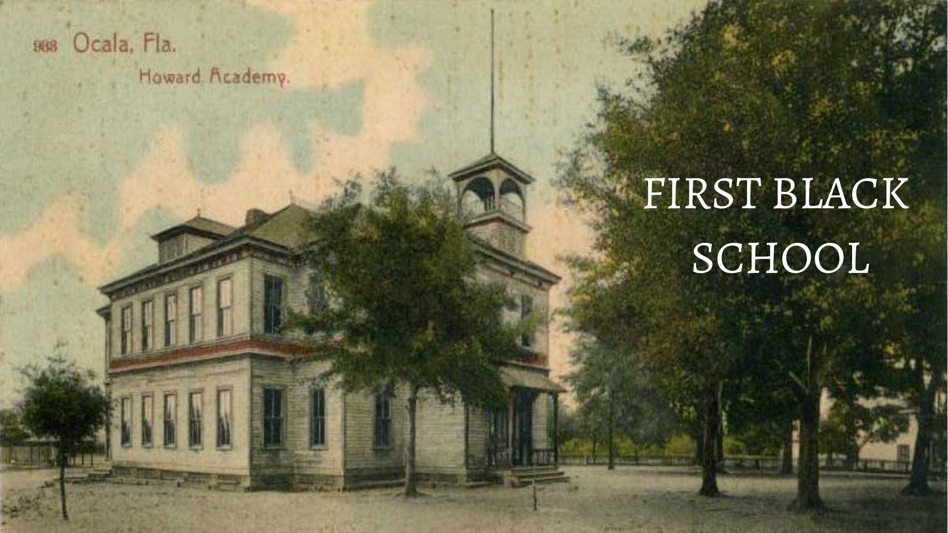

Slide 2
1866
The first Negro School (set up by the Freedmen's Bureau at the end of the Civil War) began in 1866. The school opened in March of 1866 with sixty pupils. The school was staffed by a teacher from the Missionary Aid Association. Its original location is unknown. The following year, the school moved to a log church- schoolhouse in the southern part of the town. This old building was about 20 feet by 30 feet. The grade system was unknown. Children of all ages went to school together and were taught in the same room by the same teacher. Some of the teachers in that building were Kitty Black, Jordan Taylor, and Margaret Eichelberger. School classes was held in this log church- schoolhouse until the first permanent school building was built.

Slide 3
1868
The Freedmen’s Bureau erected the Howard Academy on the corner of Osceola and Third Streets in June 1868, and officially opened it for use on November 2, 1868. The school was named for General Oliver O. Howard, the first and only director of the Freedmen's Bureau. The school began with 44 pupils in attendance and a non-graded format. It consisted of two rooms and was made out of wood. The school soon was enlarged to six classrooms. This original school burned down and was rebuilt. After it burned a second time, the third known school was built at Adams and Bay Streets.

Slide 4
The 1870’s
The first teacher of the school was Catherine Bent, a white woman. The New York Branch of the Freedmen's Union Commission paid her salary and board. The following year, Bent left and Emelie C. Stowe, who was also white, became the second teacher of the school. Most of her salary was paid by American Missionary Society of the Congregational Church. By the early 1870s the school became part of the county's new public school system. The first principal was William J. Simmons.

Slide 5
1897
In 1897, students moved to the corner of Adams Street and Bay Street where a new two story frame structure had been erected. The cost of building was about $4000. The school had a large bell tower which crowned the original entrance to the building. Its church like construction made the building a landmark in the area. Grades one through four were taught on the first floor and grades five through eight on the upper floor. The school opened on October 18, 1897, with 196 students. Enrollment reached 329 students by the end of the first year. B.F. Hartwell was the principal.

Slide 6
The 1900’s
In 1900, the school awarded diplomas to its first graduates: Priscilla Davis, Lula Jacobs, and Maggie Kinsler. In 1915, the 2nd building was erected to help alleviate the continuing crowded conditions due to increasing enrollment. The longest serving principal of the school was James D. McCall. He held the position from 1906 to 1921. There was no official date for the beginning of the high school, but it is believed to be around 1927. In 1934, a fire damaged the high school building beyond repair, and the building was razed soon after. During this time classes were held at various places within the community. In 1936 a brick school was built on the site of the old burned high school.

Slide 7
Mid-1900’s & 2000’s
As enrollment increased, additional expansion was necessary. In 1949, the elementary students moved to the new Madison Street Elementary School, and in 1955, high school students moved to the new Howard High School building at the corner of 24th and Lincoln Streets, and the grades 4-8 remained at the site. The school principal was Walter L. Hartsfield Jr. Under his leadership, the school became accredited by the Southern Association of Colleges and Schools, and the school's name was changed to Howard High School. In 1955 there were 338 students. Howard High School continued to serve black students from the ninth graders through the twelfth graders until 1969, when the county integrated its schools. The former campus was renamed Howard Elementary and later dedicated as Howard Upper Elementary. In 2002 it was placed on the National Register of Historic Places.

Slide 8
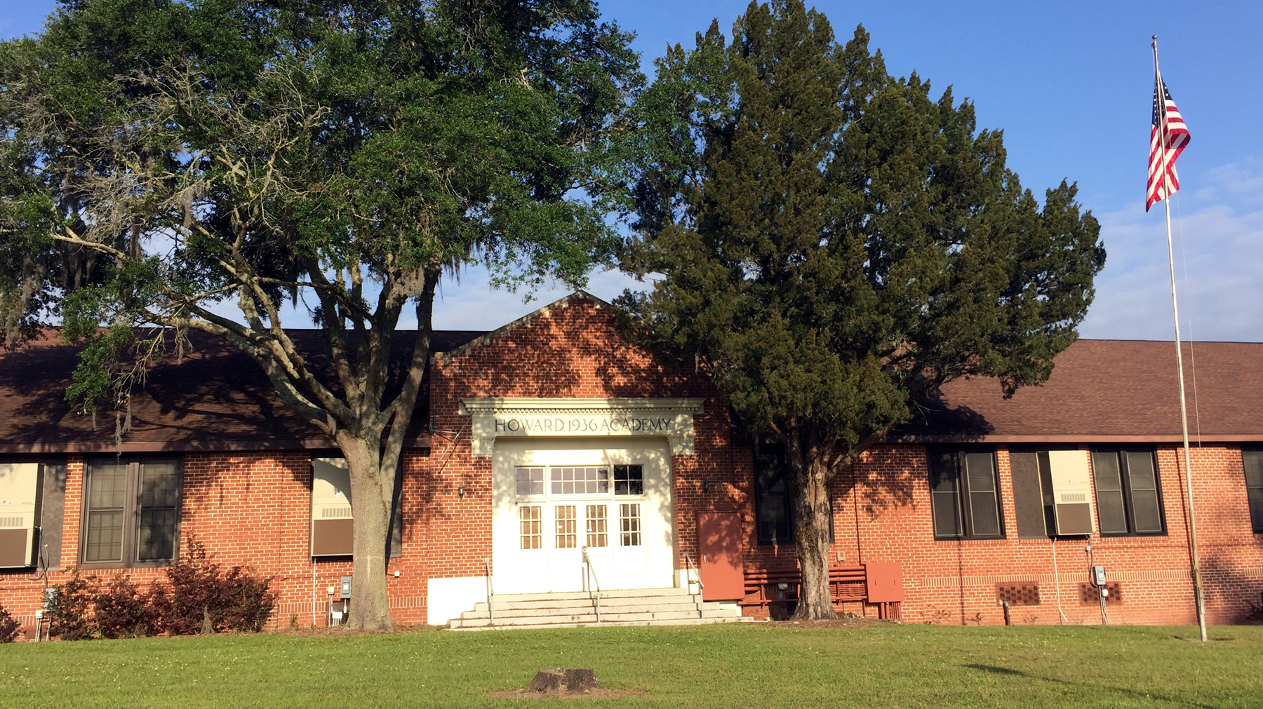
Howard academy

